Slide 1

Introduction to Deep Learning Applications and Theory
Week 8
Lecture 22
ECE 596 / AMATH 563

Slide 2
Previous Week:
Advanced Applications of RNNs
Applications – NLP, Timeseries
Preparation
Filtering
Completion
Prediction
Forcasting
Translation
Reconstruction
Anomaly Detection

Slide 3
This Week:
Generative Models and Adversaries
Generative Models Definition
Generative Models Taxonomy
Fully Visible BN
Variational Approach

Slide 4
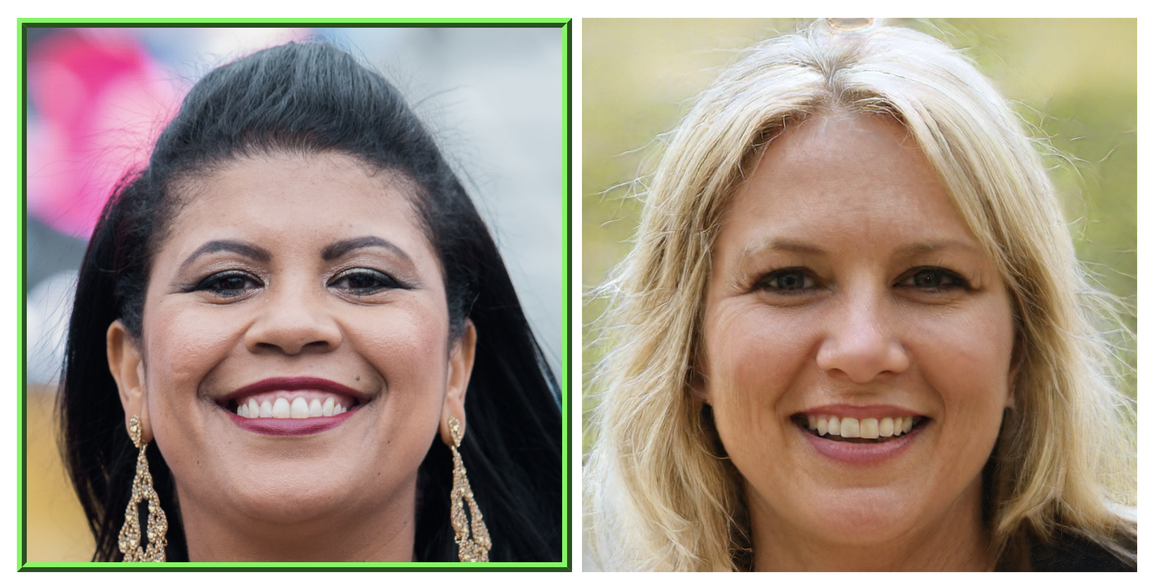
Generative Models
Training Data
Generated Samples
Training Data ~ P_{data}(x)
Generate Samples ~ P_{model}(x)
http://www.whichfaceisreal.com/
Density estimation – core problem in unsupervised learning

Slide 5
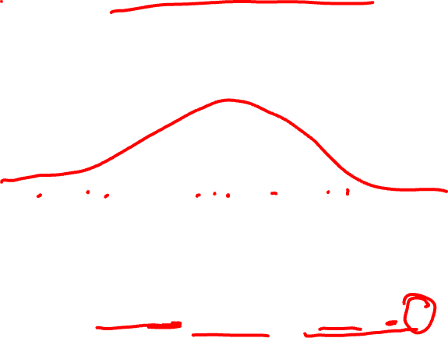
Maximum Likelihood
Model params
$$θ^{∗}=argmax_{θ} E_{x\sim p_{data}} log p_{model}(x|θ)$$

Slide 6

Density Estimation
Explicit – explicitly define and generate P_{model}
Implicit - generate P_{model} without defining P_{model}
exactly

Slide 7
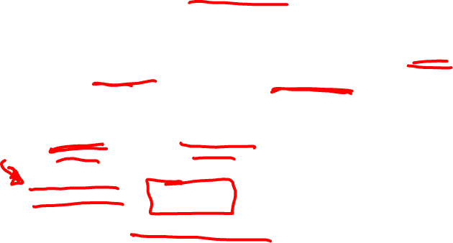
Taxonomy of Generative Models
Density Estimation
Direct
Ian Goodfellow
GAN
Explicit Density
Implicit Density
Tractable Density
Approximate Density
Markov Chain
Fully Visible BN
Pixel RNN / CNN
Nonlinear ICA
Variational
Markov Chain
Variational Autoencoder

Slide 8

FVBNs
Explicitly formula based on chain rule:
$p_{model}(x)$ = $p_{model}\left(x_{1}\right)Π_{i=2}^{n}p_{model} \left(x_{i} \right|x_{1},x_{2},…,x_{i−1})$
O(n) generation cost
No control through hidden variables

Slide 9
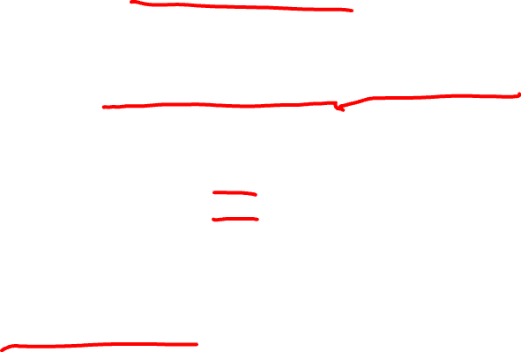
Language Model
Language model: probability distribution over sequences of words. Given such a sequence, say of length m, it assigns a probability to the whole sequence.
P(W=SpaceX will take me to Mars) = p1
P(W=SpaceX will bake me to Mars) = p2
p2 << p1
Chain rule is used to estimate probability:
P(W) = P(SpaceX) P(will|SpaceX) P(take|SpaceX will) P(me|SpaceX will take)
P(to|SpaceX will take me) P(Mars|SpaceX will take me to)

Slide 10
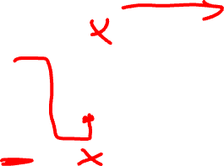
RNN Language Model
^{<1>} = P₁
^{<2>}
^{<END>}
a^{<0>}
Training:
…
x^{<1>}
y^{<1>}
y^{<Ty>}
SpaceX ... Mars
^{<1>}
^{<2>}
^{<Ty>}
^{<END>}
a^{<0>}
Sampling:
…
x^{<1>}

Slide 11
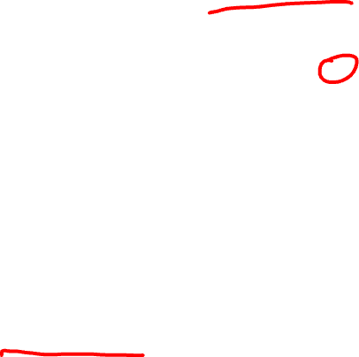
Pixel RNN
Pick a pixel and sample it;
Typically top left corner
Van der Ord et al. 2016

Slide 12
Pixel RNN
Pick a pixel and sample it;
Typically top left corner
Connect to neighbor pixels
with RNN
Van der Ord et al. 2016

Slide 13

Pixel RNN
Pick a pixel and sample it;
Typically top left corner
Connect to neighbor pixels
with RNN
Generate neighbors
Van der Ord et al. 2016

Slide 14
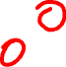
Pixel RNN
Pick a pixel and sample it;
Typically top left corner
Connect to neighbor pixels
with RNN
Generate neighbors
Continue
Van der Ord et al. 2016

Slide 15

Pixel RNN
Pick a pixel and sample it;
Typically top left corner
Connect to neighbor pixels
with RNN
Generate neighbors
Continue
Van der Ord et al. 2016

Slide 16
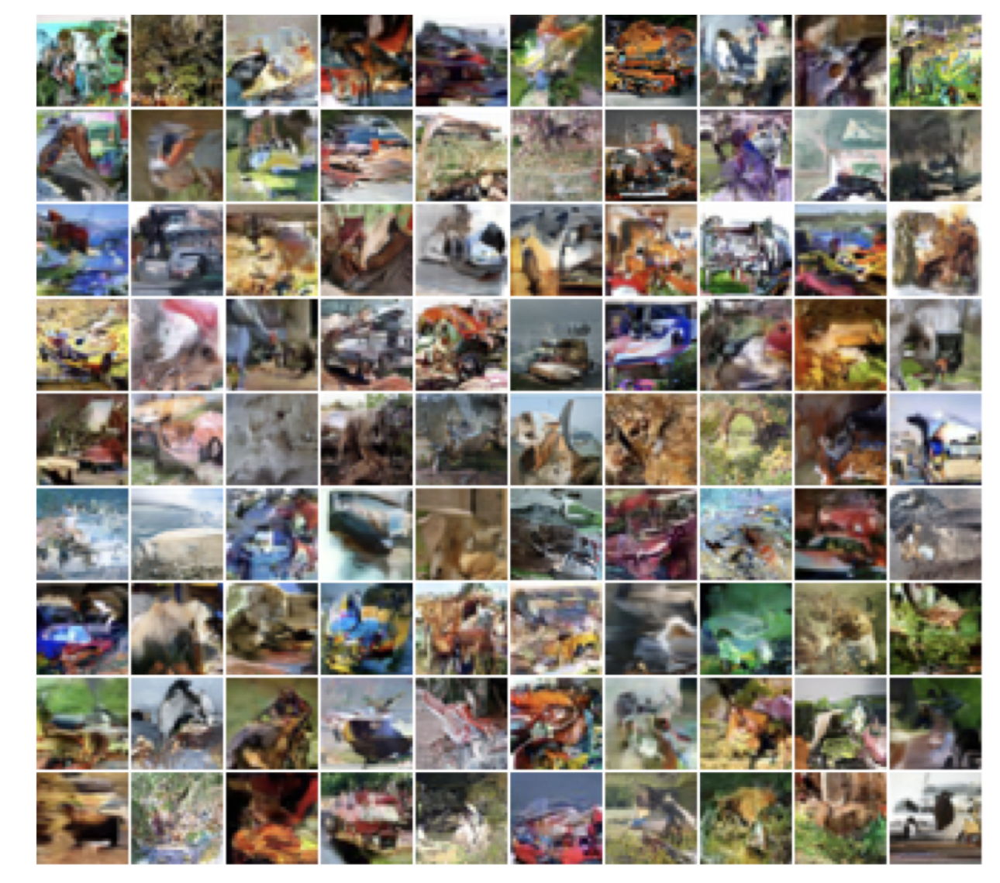
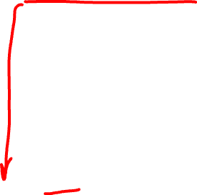
Pixel RNN
CIFAR 10 Generations
Van der Ord et al. 2016

Slide 17
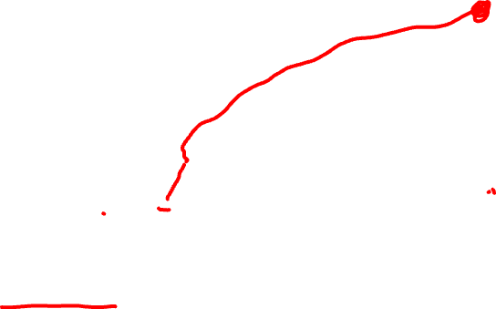
WaveNet
Oord et al. (2016) WaveNet: A Generative Model for Raw Audio

Slide 18
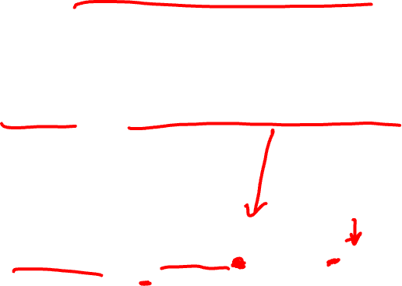
Variational Autoencoder
$p_{model}(x)$ = $Π_{i=2}^{n}p_{model} \left(x_{i} \right|x_{1},x_{2},…,x_{i−1})$
$$p_{model}\left(x\right)= \int{p_{model}\left(z\right)p_{model}(x|z)}dz$$

Slide 19
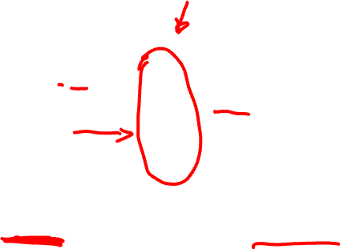
Structurally
x
z
Encoder
Decoder
$$\hat{x}$$
Usually smaller
than x
Input data
Generated input
data
Loss

Slide 20
Variational Autoencoders Generating Data
Choose prior p(z) to be simple:
Gaussian
Define a network to generate
the conditional
z
Decoder
$$\hat{x}$$
Sample from:
$$p_{model}\left(z\right)$$
$$p_{model}\left(x | z^{(i)}\right)$$
Kingma & Welling (ICLR 2014)

Slide 21
Variational Autoencoders Generating Data
Training:
z
$$p_{model}\left(x\right)= \int{p_{model}\left(z\right)p_{model}(x|z)}dz$$
Decoder
$$\hat{x}$$
Sample from:
$$p_{model}\left(z\right)$$
$$p_{model}\left(x | z^{(i)}\right)$$
Kingma & Welling (ICLR 2014)

Slide 22

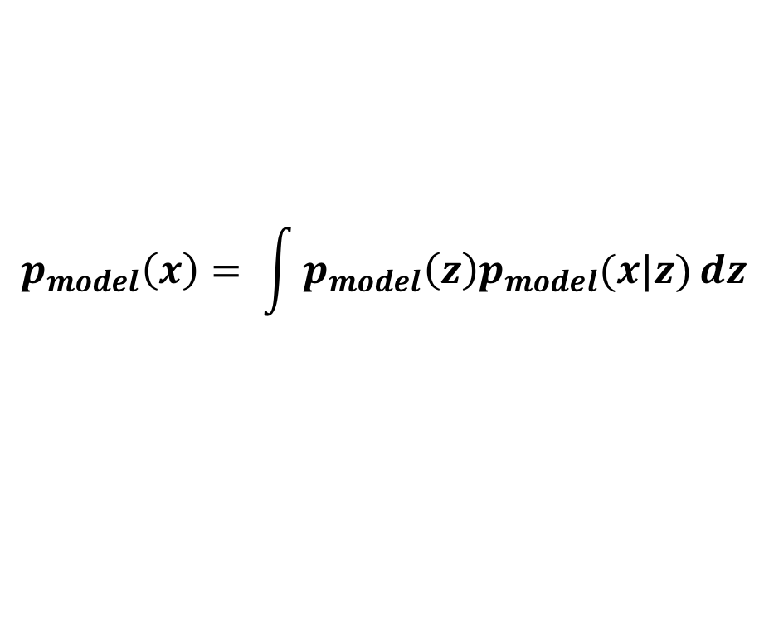
Variational Autoencoders Generating Data
$$p_{model}\left(z|x\right)=p_{model}\left(x | z\right)p_{model}\left(z\right)/p_{model}\left(x\right)$$
Gaussian
Decoder: Neural Network
$$p_{model}\left(x\right)= \int{p_{model}\left(z\right)p_{model}(x|z)}dz$$
Intractable
Solution: use an encoder which approximates
$$p_{model}\left(z|x\right)$$
$$q_{model}^{Φ}\left(z|x\right)$$
Kingma & Welling (ICLR 2014)

Slide 23
Generative Encoder and Decoder
x
$$Σ_{z|x}^{Φ}$$
Encoder
Sample z from $z|x$ ~ N($Σ_{z|x}^{Φ}$, $μ_{z|x}^{Φ}$)
$$μ_{z|x}^{Φ}$$
$$q_{model}^{Φ}\left(z|x\right)$$
Notes:
Mean and diagonal covariance

Slide 24
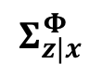
Generative Encoder and Decoder
z
$$Σ_{z|x}^{Φ}$$
Decoder
Sample x|z from $x|z$ ~ N($Σ_{x|z}^{Φ}$, $μ_{x|z}^{Φ}$)
$$μ_{z|x}^{Φ}$$
$$p_{model}^{θ}\left(x|z\right)$$
Notes:
Mean and diagonal covariance

Slide 25
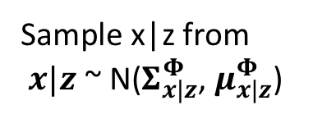
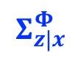
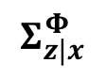
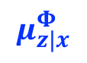
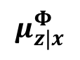
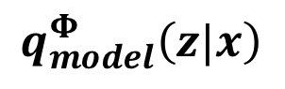
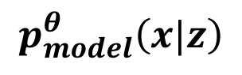
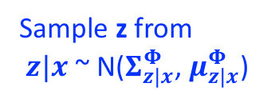

Variational Autoencoder Putting it All Together
x
$$Σ_{z|x}^{Φ}$$
$$Σ_{z|x}^{Φ}$$
Sample z from
$z|x$ ~ N($Σ_{z|x}^{Φ}$, $μ_{z|x}^{Φ}$)
Encoder
Sample x|z from
$x|z$ ~ N($Σ_{x|z}^{Φ}$, $μ_{x|z}^{Φ}$)
$$\hat{x}$$
z
$$μ_{z|x}^{Φ}$$
$$μ_{z|x}^{Φ}$$
$$q_{model}^{Φ}\left(z|x\right)$$
$$p_{model}^{θ}\left(x|z\right)$$
2
1

